Slide 1
ELECTRICITY BILLING SYSTEM

Slide 2
AIM OF THE PROJECT
Electricity Billing System is a software-based application developed in Java programming language.
The main objective is to GET the details of Electricity Bill.
WE CAN GENERATE ELECTRICITY BILL ACCORDING TO POWER CONSUMED AND CHARGES.

Slide 3
SOFTWARE AND HARDWARE REQUIREMENTS
HARDWARE REQUIREMENTS
Processor : intel i5
RAM : 8 gb
HARD DISK DRIVE : 500 gb
SOFTWARE REQUIREMENTS
Front End : Java Swing
Back End : JAVA

Slide 4
PROPOSED SYSTEM
Proposed System is AN ELECTRICITY BILL GENERATION SYSTEM.
User friendly interface.
QUICK BILL GENERATION ACCORDING TO POWER CONSUMED & CHARGES.

Slide 5
MODULE LIST
CUSTOMER ID
CUSTOMER NAME
UNIT
CAL
PRINT

Slide 6
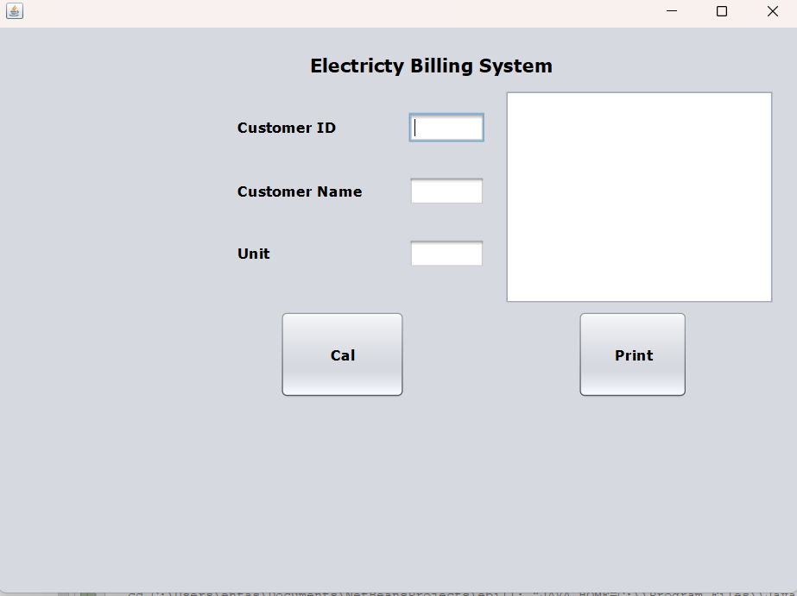
HOME PAGE

Slide 7
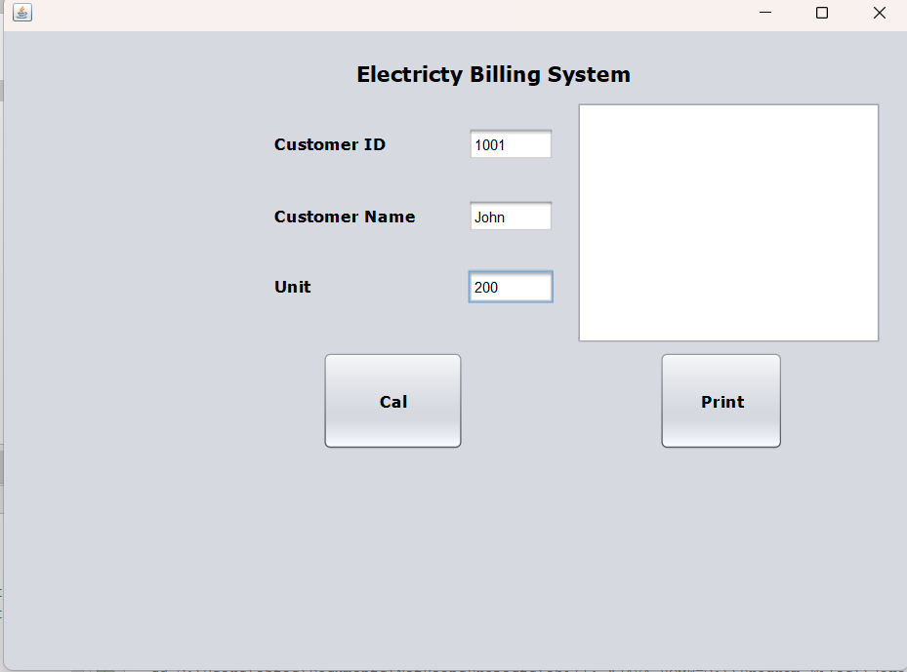

Slide 8
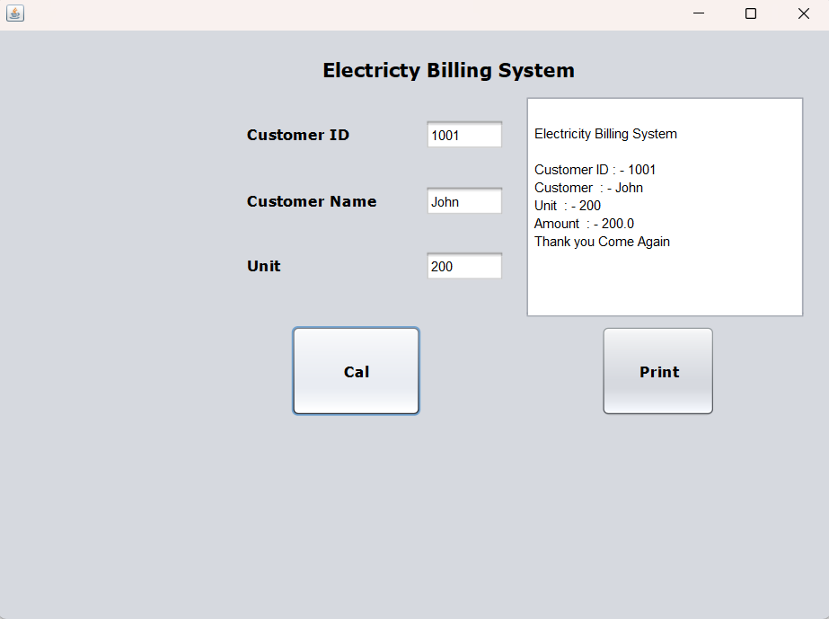
BILL GENERATED

Slide 9
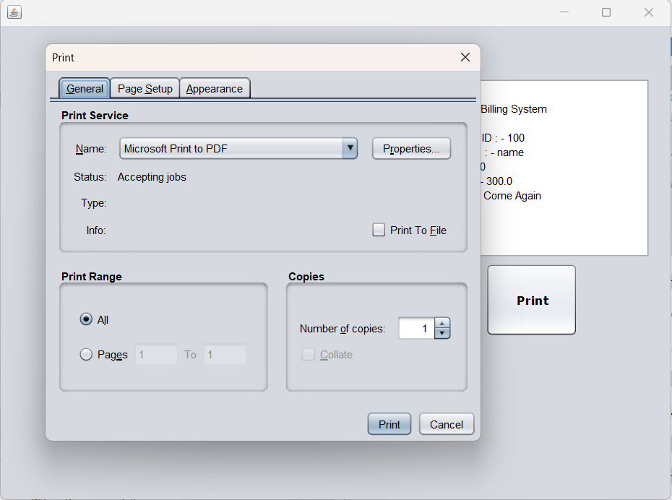
PRINTING BILL

Slide 10
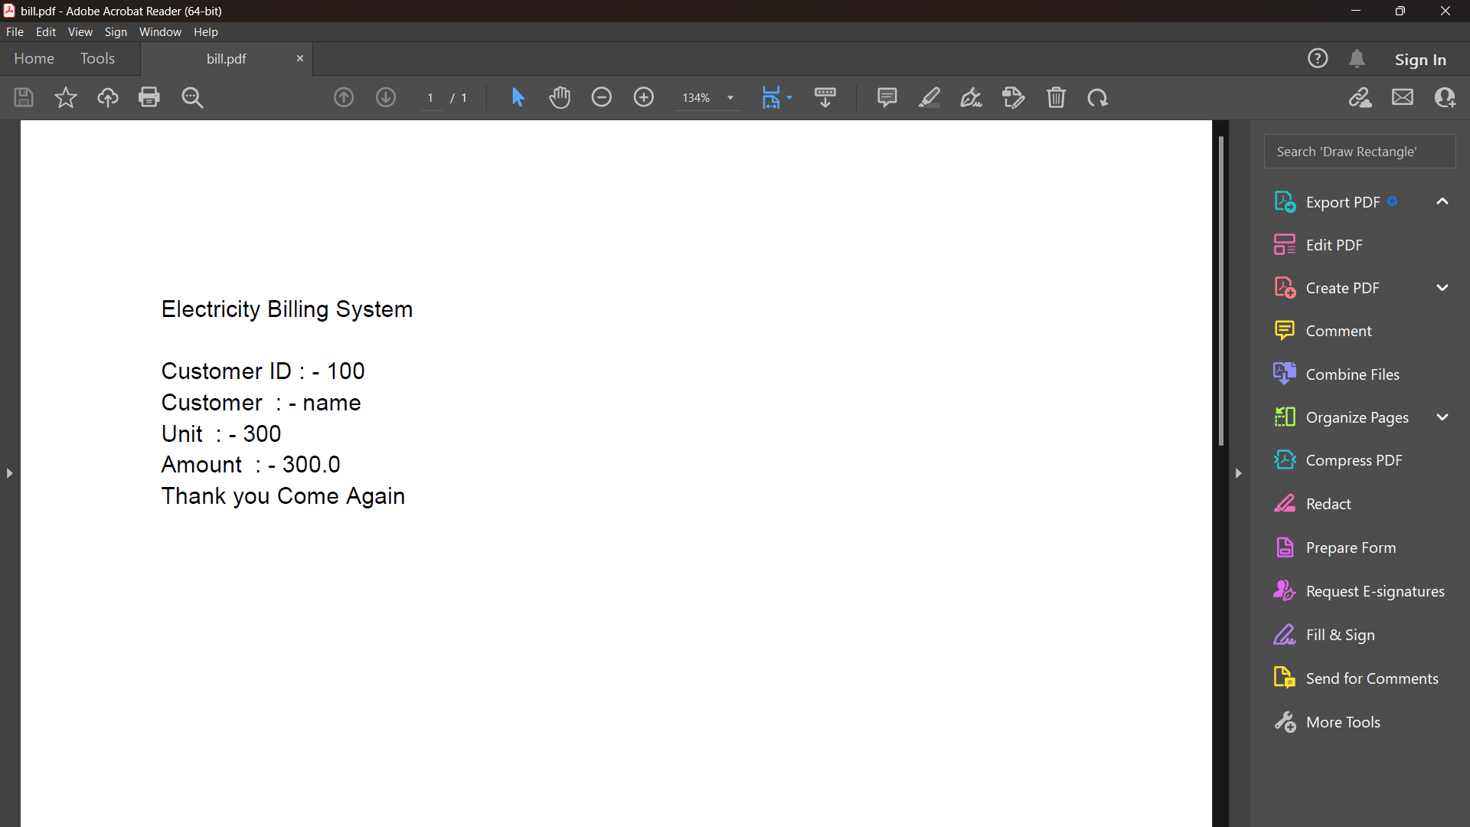
BILL PRINTED

Slide 11
THANK YOU

